Slide 1


SOFTWARE MANAGEMENT SYSTEM
Team number 7
Under the guidance
G L Narasamba Vanguri
Presented by team
A. Chandini 26B21AI002
B.Reshma 26B21AI012
T.Harika 25B11AI982
T.Bhargavi 25CB11AIC15
Department:AI&ML

Slide 2

PROBLEM STATEMENT
Organizations use multiple software applications for development, testing, designing, communication, and other activities. Managing software information, licenses, installations, and employee requests manually can lead to:
Difficulty in tracking software installations
License expiry and renewal issues
Duplicate or unauthorized software usage
Difficulty managing software requests
Lack of centralized software information
Time-consuming manual record maintenance
Solution:
The proposed Software Management System provides a centralized database to manage software, employees, licenses, installations, departments, and software requests efficiently

Slide 3

OBJECTIVES
To maintain centralized software information.
To manage employee and department details.
To track software licenses and expiry dates.
To maintain software installation records.
To manage employee software requests.
To establish relationships between different entities.
To provide accurate and organized database records
.
To support future reporting and software management.

Slide 4
ENTITIES & THEIR ATTRBUTES
Entity | Primary Key | Important Attributes
Client | Client_ID | Name, Email, Phone, Company
Employee | Employee_ID | Name, Email, Phone, Designation
Department | Department_ID | Department_Name, Location
Project | Project_ID | Project_Name, Start_Date, End_Date, Status, Budget
Task | Task_ID | Task_Name, Description, Due_Date, Status
Technology | Technology_ID | Technology_Name, Version
Software | Software_ID | Software_Name, Version, License, Cost
Project_Employee | Project_ID + Employee_ID | Role, Assigned_Date
Project_Technology | Project_ID + Technology_ID | Usage_Type

Slide 5

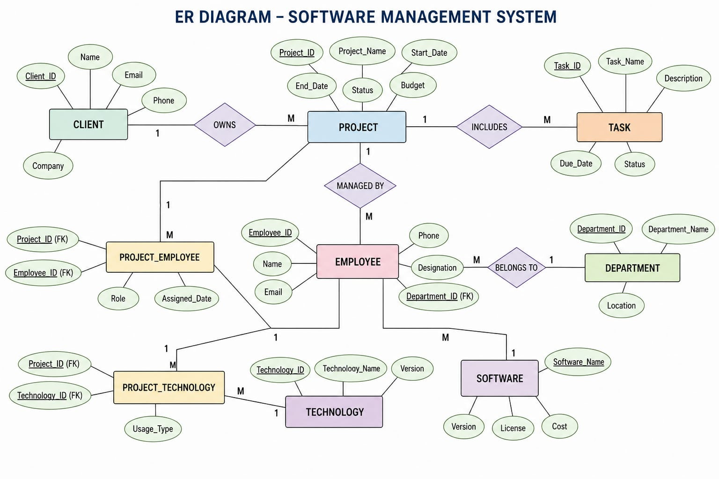
ER DIAGRAMS

Slide 6

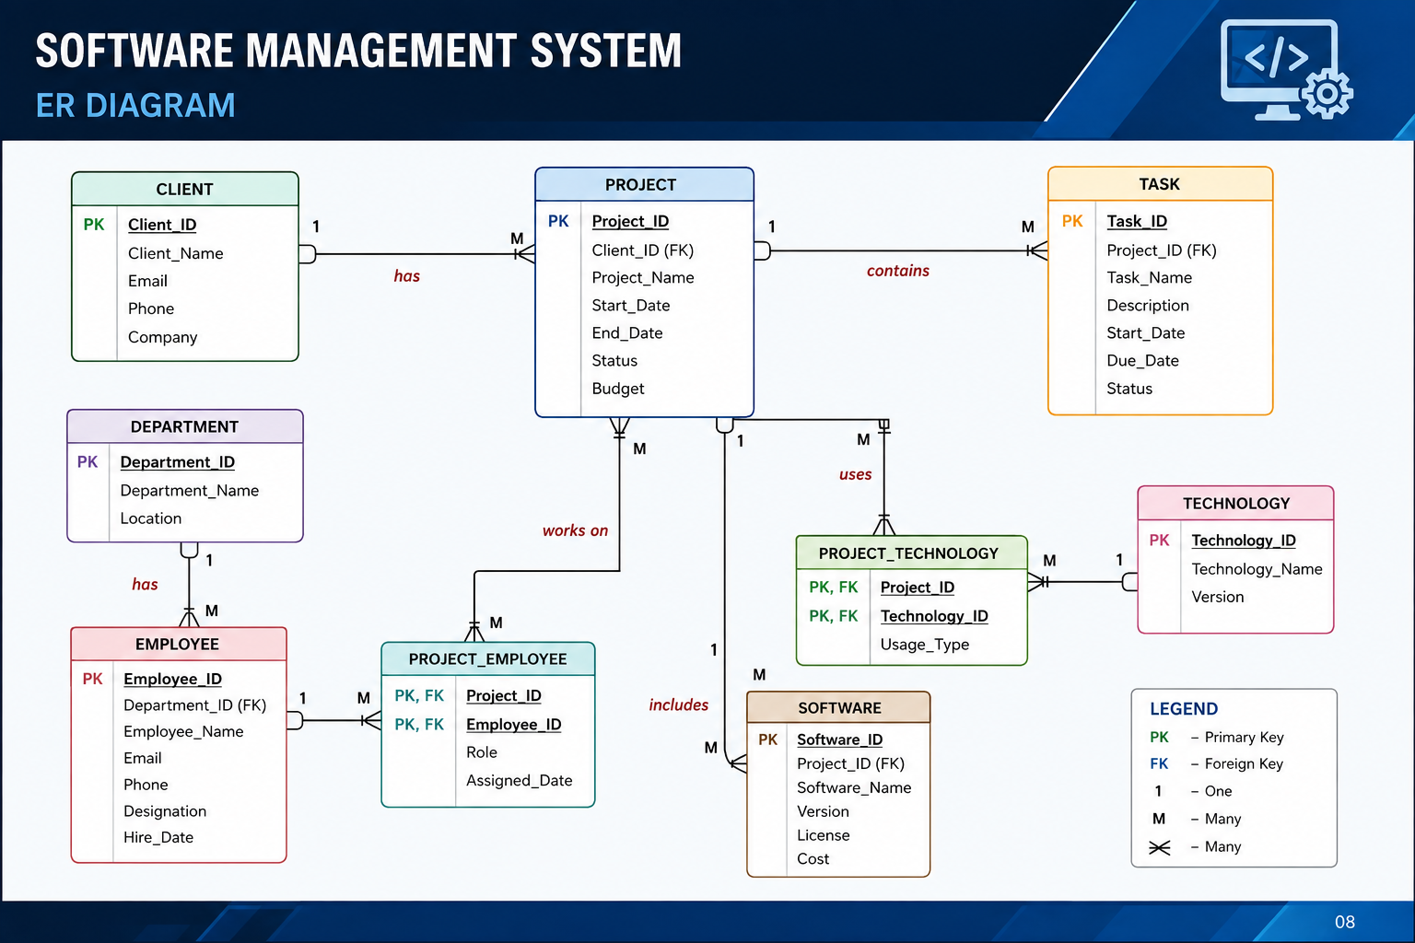
RELATIONAL DATABASE SCHEMA

Slide 7
PRIMARY KEY
FOREIGN KEY
A Foreign Key (FK) connects one table with another table.
Examples:
Employee.Department_ID → Department.Department_ID
Project.Client_ID → Client.Client_ID
Task.Project_ID → Project.Project_ID
Software.Project_ID → Project.Project_ID
For M:N relationships:
Project_Employee
Project_ID → Project
Employee_ID → Employee
Project_Technology
Project_ID → Project
Technology_ID → Technology
A Primary Key (PK) uniquely
identifies each record in a table.
Examples:
  Client_ID → Client
  Employee_ID → Employee
  Project_ID → Project
  Task_ID → Task
  Technology_ID → Technology
  Software_ID → Software

Slide 8
THANK YOU

